Slide 1
MPXV 논문 요약(1)
2024.07.17
Sol Kim

Slide 2
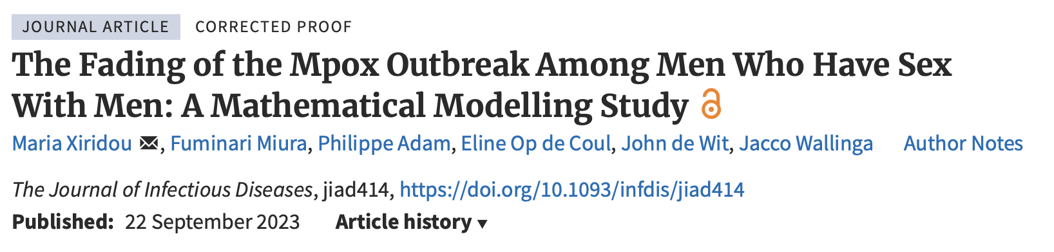
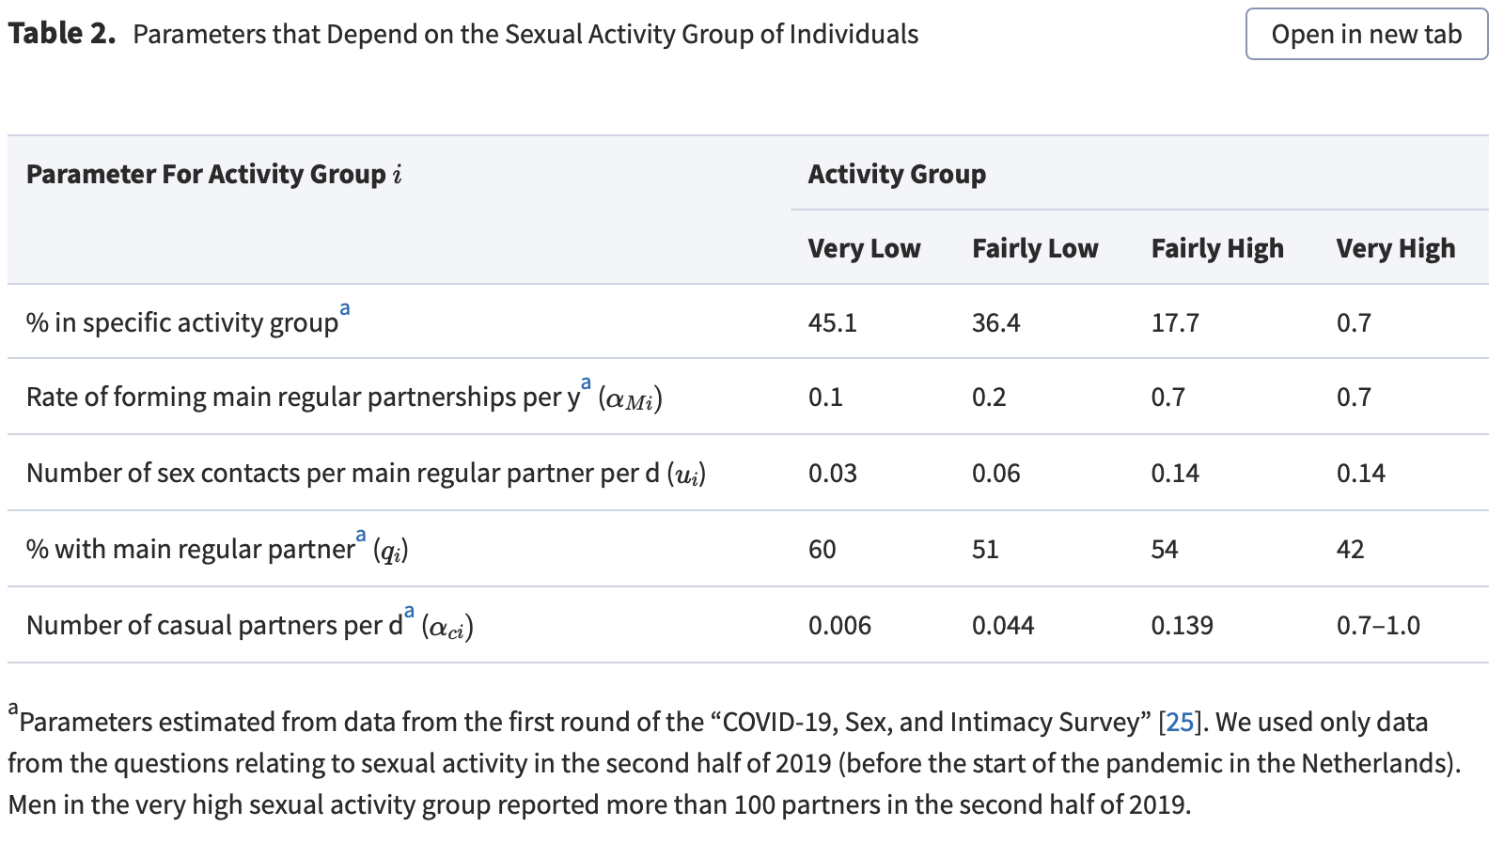
Identify the question
Our study aimed to assess the factors that may have led to the decline in the number of mpox cases observed in the Netherlands before the start of the mpox vaccination program.
Identify existing knowledge
Daily numbers of mpox cases
started declining in the second week of July 2022
the mpox vaccination program started
With / Without 2022 vaccine
the number of mpox cases increased sharply in June 2022
close contacts of individuals diagnosed with mpox were offered vaccination
The earliest date of symptom onset among confirmed mpox cases.
Aug 2022
online survey
2022
04.27
2022
06
2022
06.08
the second week of July
2022
07.25
The end of 2022

Slide 3
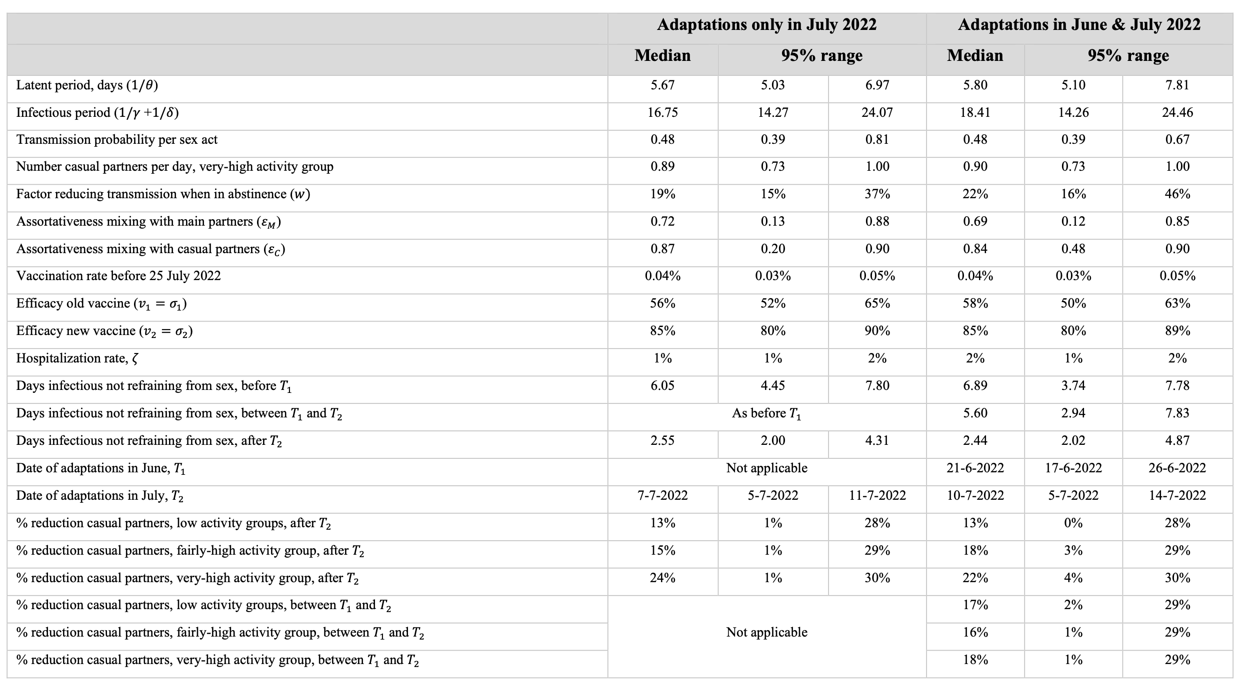
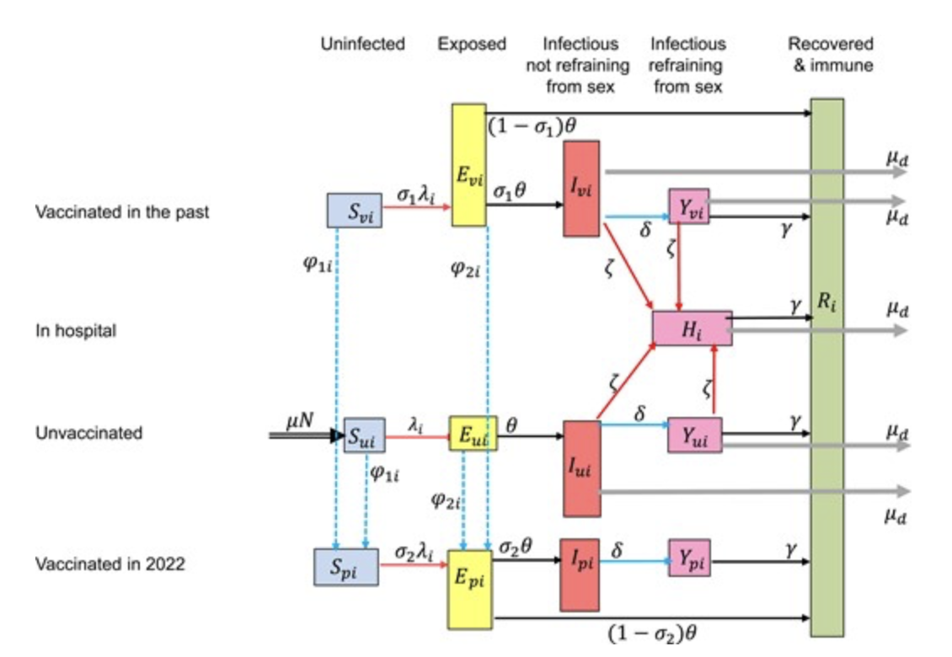
Choose model structure
Heterogeneous SEIYR (with vaccine in 2022, vaccine in past)
Choose modelling method
Deterministic compartment model
Model quantification

Slide 4
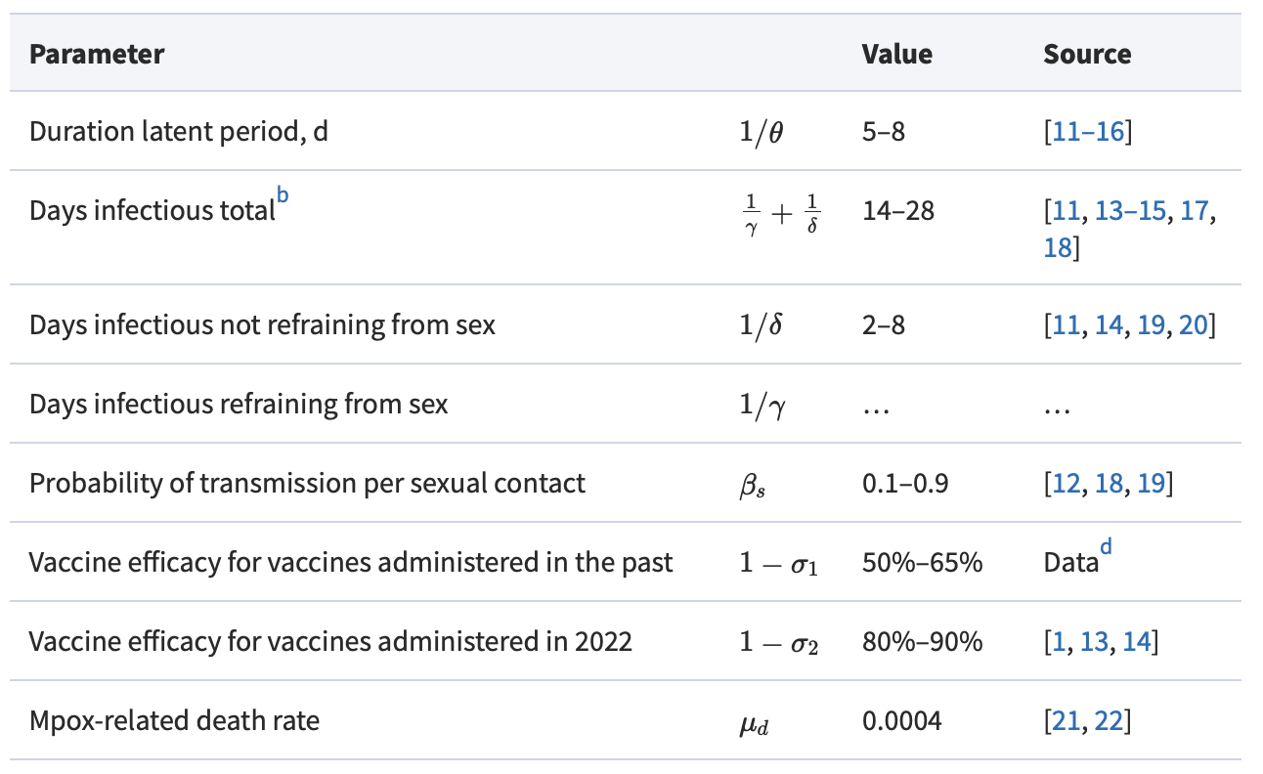
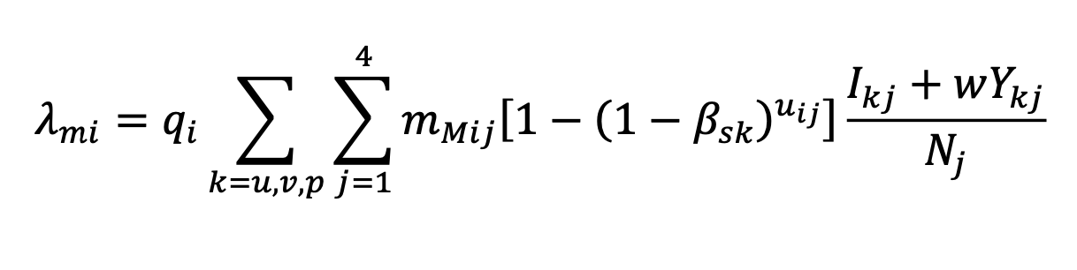
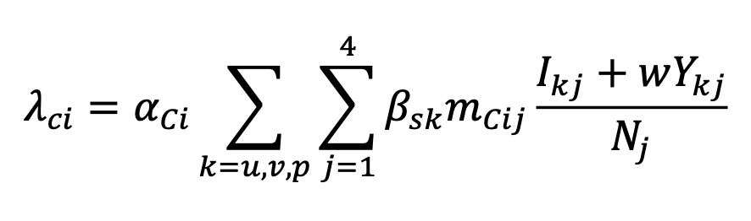
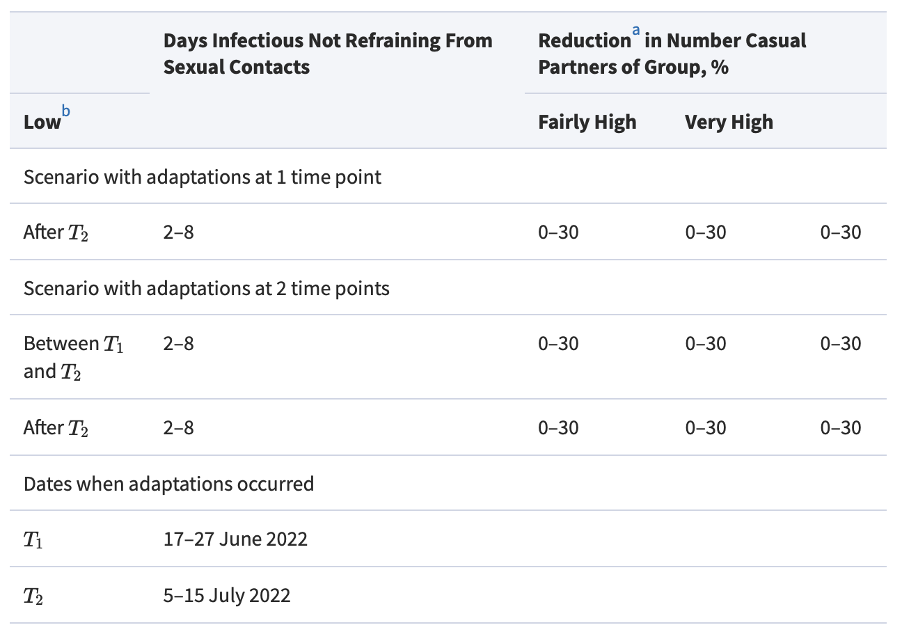
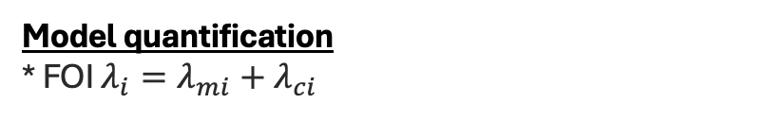
Model quantification
* FOI $λ_{i}=λ_{mi}+λ_{ci}$

Slide 5
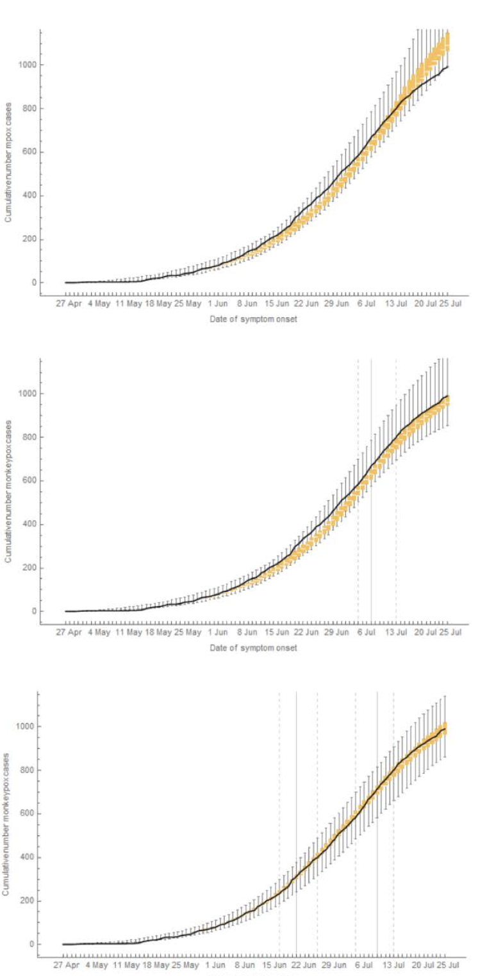
Behavioral adaptation (x)
Model quantification and validation
Behavioral adaptation only in July
Behavioral adaptation in June and in July
Data analysis (statistical modelling) – Bayesian approach
Notes:
Model validation 방법에 대해 조사하고 실험해볼 목록을 만들어야 한다.
Behavioral adaptation 이 6-7월에 있었냐? 7월에 있었냐?
MSM인구가 250 000이라 나와있긴한데 200 000 으로 했을때, 300 000으로 했을 때 확진자 그래프가 어떻게 달라지는지
저런 그래프가 나오게 하기 위해 변수 추출을 10000번 했다는 것은 PSA하듯이 시뮬레이션을 돌려서 얻은 결과.. 인건가?>
PSA결과를 가지고 역으로 다시 변수의 가능도를 확인하고 변수 값을 추정하였다??????

Slide 6
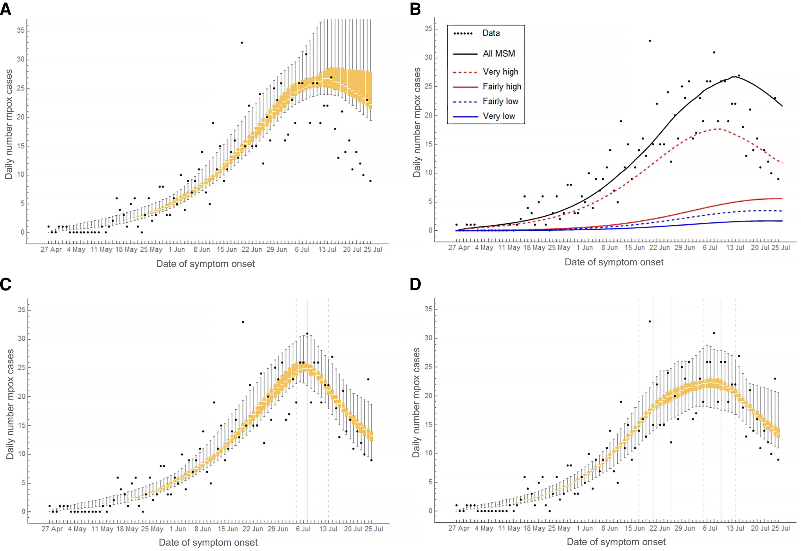
Prediction and Optimization
The Decline in the Mpox Outbreak With and Without Behavioral Adaptations
Behavioral adaptation (x)
Behavioral adaptation (x)
Behavioral adaptation only in July
Behavioral adaptation in June and in July

Slide 7
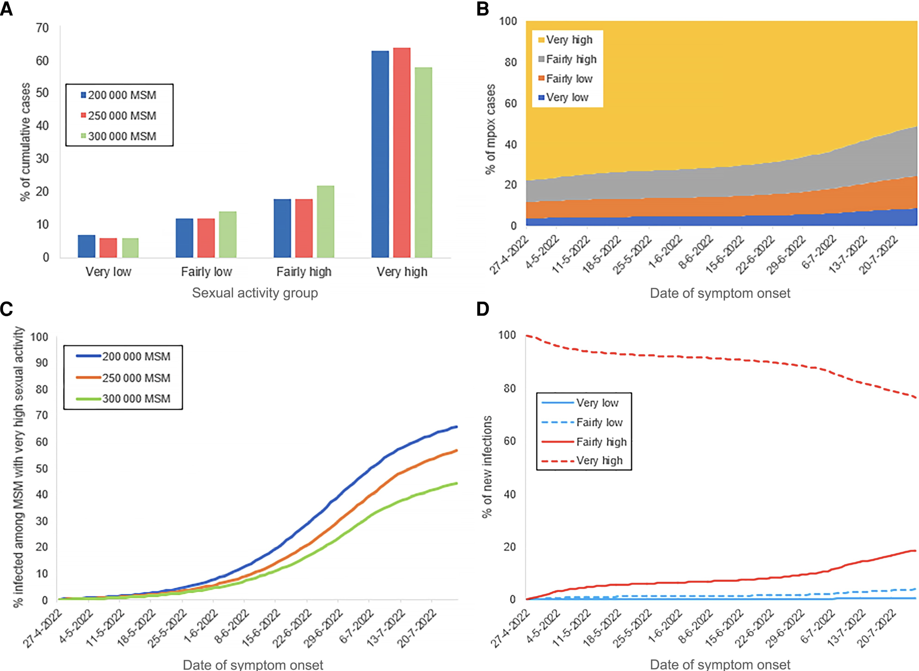
Prediction and Optimization
Distribution of Mpox Cases According to Level of Sexual Activity
Sensitivity Analysis
A. Distribution of cumulative mpox cases until 25 July 2022.
B. Distribution of daily mpox cases.
C. Percent of MSM with very high sexual activity being
susceptible to monkeypox virus.
D. Distribution of new monkeypox virus infections among MSM
according to the sexual activity group of the infecting individual.
Sensitivity Analysis

Slide 8
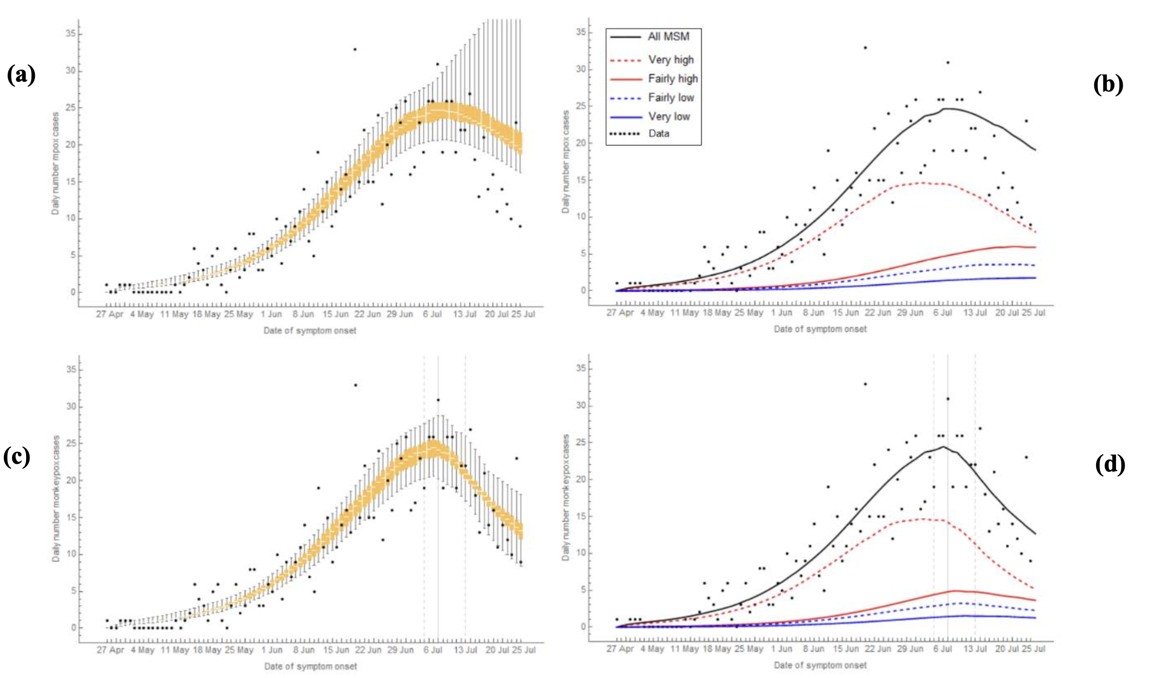
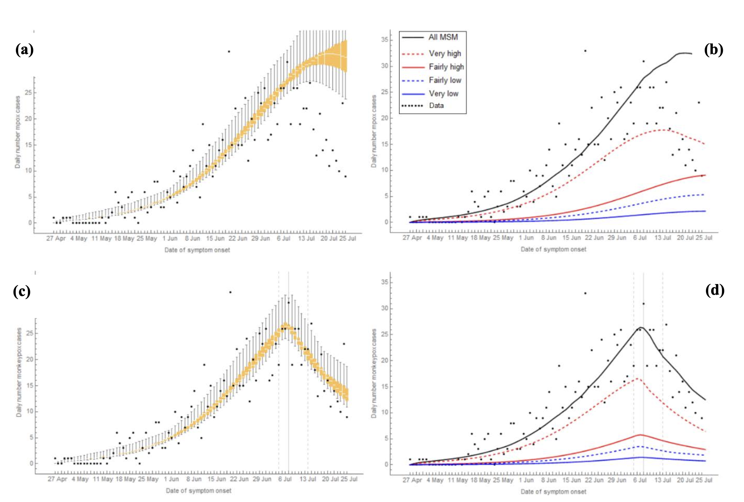
Prediction and Optimization
Sensitivity Analysis (1)
i) N = 200,000
ii) N = 300,000

Slide 9
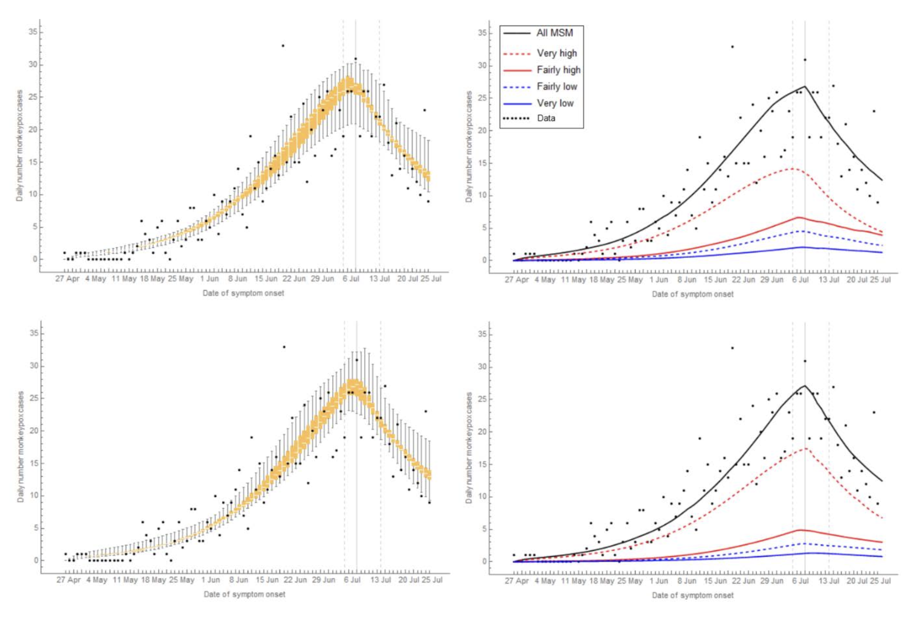
Prediction and Optimization
Sensitivity Analysis (2)
i) the percentage vaccinated in the past was the highest in the group with the highest level of sexual activity: 23%, 25%, 30%, 40%
ii) the percentage vaccinated in the past was the highest in the group with the highest level of sexual activity: 29%, 25%, 15%, 10%

Slide 10
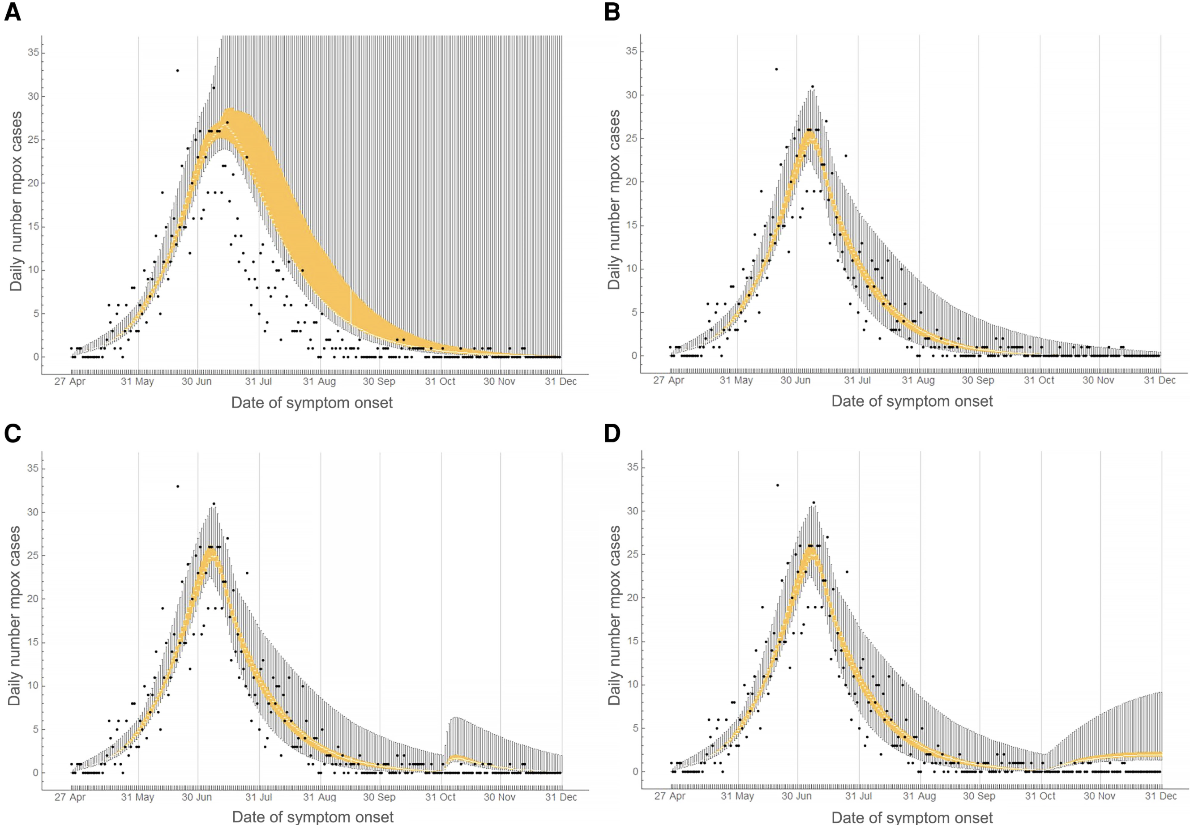
Prediction and Optimization
Hypothetical Scenarios for the Course
of the Outbreak Without Vaccination
started declining in the second week of July 2022
the mpox vaccination program started
With / Without 2022 vaccine
the number of mpox cases increased sharply in June 2022
close contacts of individuals diagnosed with mpox were offered vaccination
The earliest date of symptom onset among confirmed mpox cases.
Aug 2022
online survey
2022
04.27
2022
06
2022
06.08
2022
07.25
The end of 2022
Notes:
백신 접종 안했다는 가정하에 실험해보기
A : 행동적응 없이
B ; 행동 적응 7월에만
C : 11/1 20명 iimport
D : 11/1~12/31 매일 한명 import

Slide 11
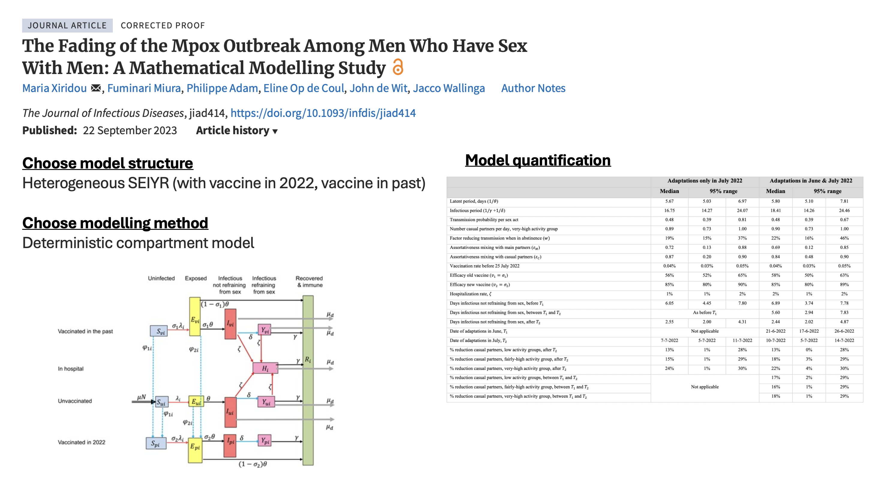
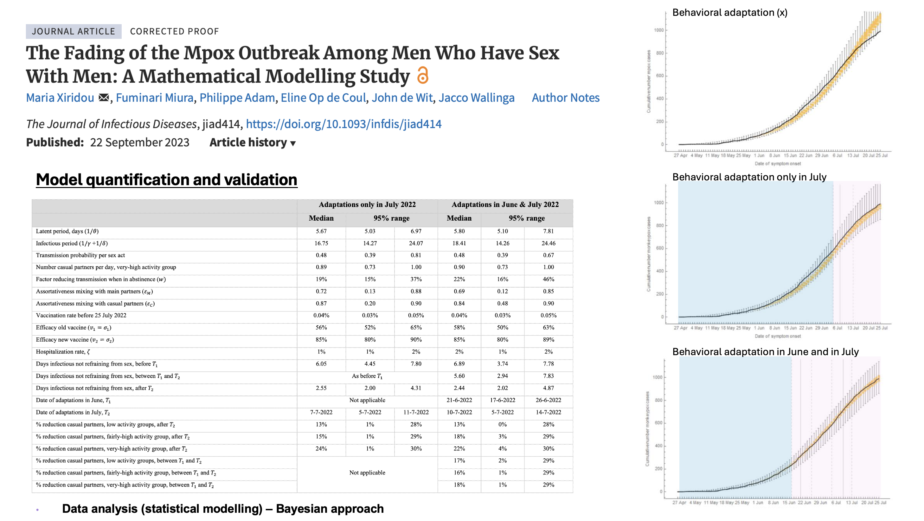
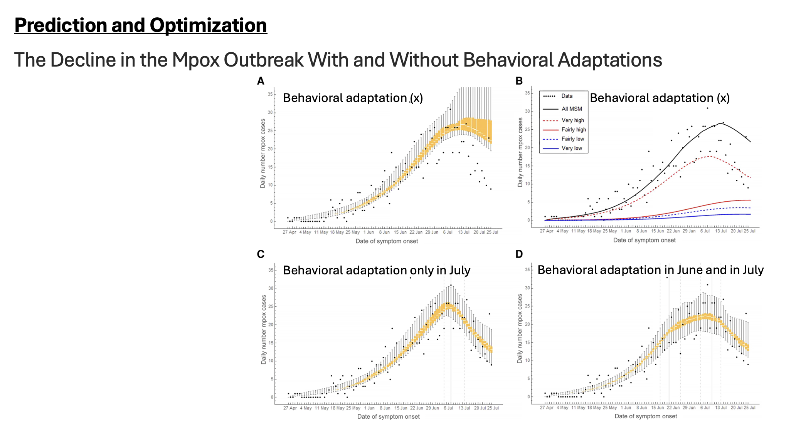
PLAN

Slide 12
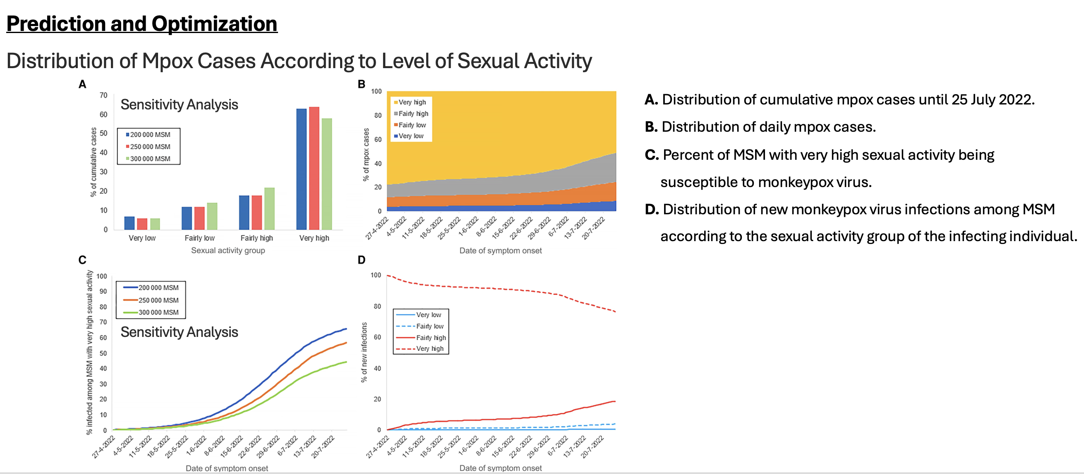
PLAN

Slide 13
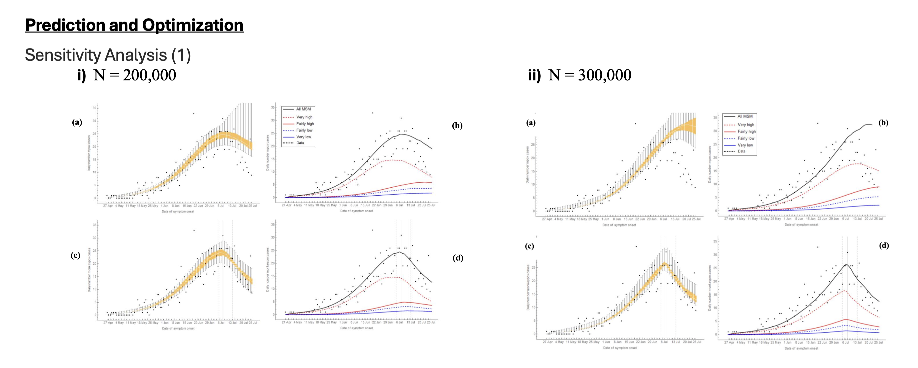
PLAN

Slide 14
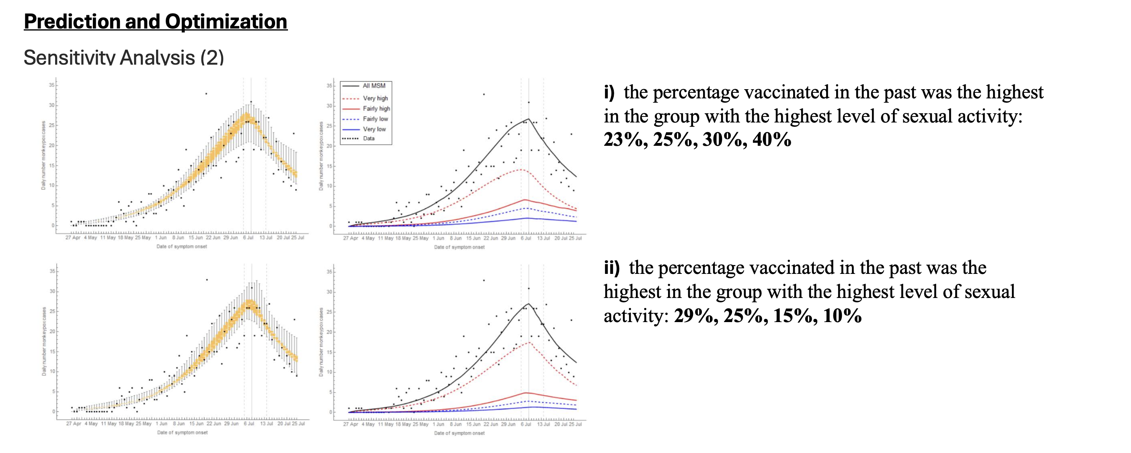
PLAN

Slide 15
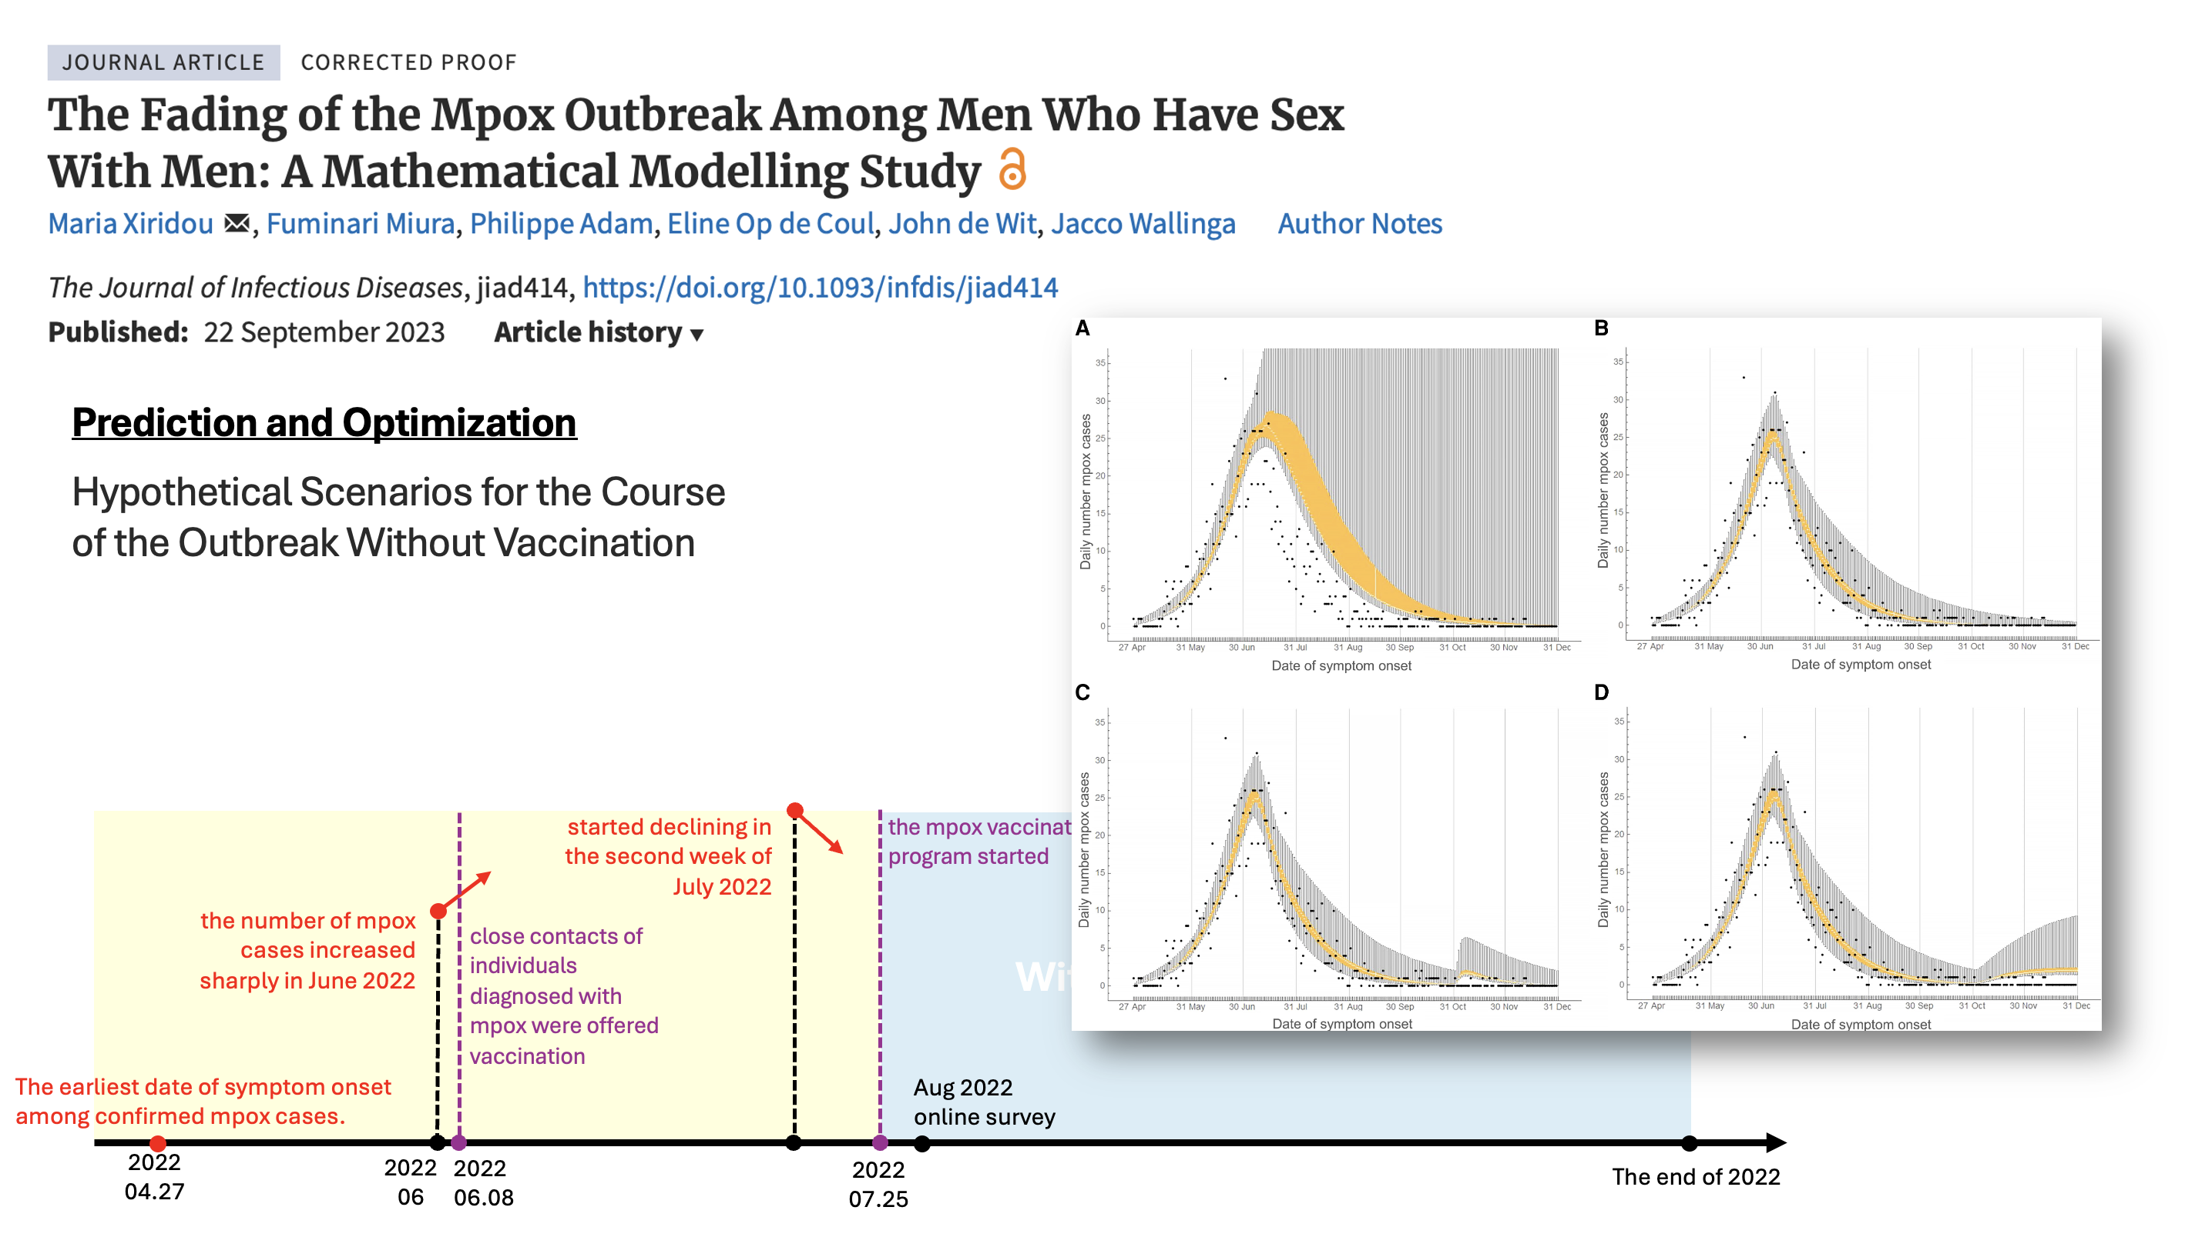
PLAN

